Slide 1
Capstone Project (Car-accident analysis) Date: Oct 2020 By: Alex Wong

Slide 2
Introduction/Business Problem Section
Background:
In this Capstone Project, we will use the
Dataset of the All collisions (car-accidents - 2004 to Present.) in Seattle
the Metadata of the dataset
provided by SPD and recorded by Traffic Records (seattle.gov) to understand the Car Accident occurred in Seattle.
The understanding of the data includes studying the factors such as
the accident severity, the accident type, the details of the accident,
the Transportation (e.g. car / bicycles) and how many people and who involved in the accident
the weather, road condition and environmental factors at the point-in-time of the accident
the location of the accident, the surrounding physical environment of the location accidents, etc.

Slide 3
Introduction/Business Problem Section
After the understanding, we will start analyzing the accident by using multiple data analytic tools and skills (e.g. pandas) learned in this course,
to understand the relation between the factors (e.g. correlation, means, frequency, max, min. etc.)
After the data analysis, we will try to
1. get insights from the data
2. make hypothesis by evaluating the relation of the data in the dataset
3. testing the effectiveness / validity of the hypothesis
4. draw conclusion and make forecast
And then using the dataset (diving into training data vs sample data) to simulate and test the effectiveness hypothesis (model).
Finally, we will write a report and resent the observation in a PPT.

Slide 4
Introduction/Business Problem Section
A description of the problem
As descripted in the background section, we aim at using the dataset & metadata to
1. draw conclusion
2. make prediction
3. represent the observation, and
4. make practical and meaningful suggestions to the settle gov,
and hence to reduce the
1. frequency and
2. severity of the accident in future.

Slide 5
Introduction/Business Problem Section
Who would be interested in this project?
The Government official of Seattle, such as Transport department traffic control team, policy station, accident investigation team
The city planning department, the education department (e.g. no speeding / driving after drinking)
Education sectors which investigate mainly the city planning, traffic accident, transportation
Conclusion of this section and also this Capstone Project
In conclusion, we hope to give recommendation to the gov. to make remediation / correction / education at the potential problematic factors (black spots) in order to prevent / reduce any car accidents in future. And the most importantly, to SAVE LIFE!

Slide 6
Data where you describe the data that will be used to solve the problem and the source of the data
A description of the data
Through studying the dataset and the meta data, we understand that the following data is are useful,
'REPORTNO', Remarks: new data, some incidents have the same report no. therefore, we keep this data to find duplication.
'STATUS', Remarks: new data, the status has two type, matched (~188k), unmatched (4800), it helps us to filter the potential incorrect / inaccurate / incomplete data. Since the total no. of unmatched is less than 1 % of the total data. Filtering out the data is acceptable and it is insignificant to the result / conclusion of the data analysis result
'SEVERITYCODE', A code that corresponds to the severity of the collision:
3—fatality
2b—serious injury
2—injury
1—prop damage
0—unknown

Slide 7
Data where you describe the data that will be used to solve the problem and the source of the data
'ADDRTYPE', Collision address type:
Alley
Block
Intersection
'INTKEY', Key that corresponds to the intersection associated with a collision
'LOCATION’, Description of the general location of the collision
'SEVERITYDESC’, A detailed description of the severity of the collision
'COLLISIONTYPE’, Collision type
'PERSONCOUNT’, The total number of people involved in the collision
'PEDCOUNT’, The number of pedestrians involved in the collision. This is entered by the state.
'PEDCYLCOUNT', The number of bicycles involved in the collision. This is entered by the state.

Slide 8
Data where you describe the data that will be used to solve the problem and the source of the data
'VEHCOUNT’, The number of vehicles involved in the collision. This is entered by the state.
'INCDATE', The date of the incident.
'INCDTTM’, The date and time of the incident.
'‘JUNCTIONTYPE '‘, The of junction at which collision took place
'SDOT_COLCODE', A code given to the collision by SDOT.
'SDOT_COLDESC', A description of the collision corresponding to the collision codes.
'INATTENTIONIND', Whether or not collision was due to inattention. (Y/N)
‘UNDERINFL’, Whether or not a driver involved was under the influence of drugs or alcohol.
'WEATHER', A description of the weather conditions during the time of the collision
'ROADCOND', The condition of the road during the collision.
'LIGHTCOND’, The light conditions during the collision.
'PEDROWNOTGRNT', Whether or not the pedestrian right of way was not granted. (Y/N)
'SPEEDING', Whether or not speeding was a factor in the collision. (Y/N)

Slide 9
Data where you describe the data that will be used to solve the problem and the source of the data
'ST_COLCODE’, A code provided by the state that describes the collision.
'ST_COLDESC', A description that corresponds to the state’s coding designation.
'SEGLANEKEY', A key for the lane segment in which the collision occurred.
'CROSSWALKKEY', A key for the crosswalk at which the collision occurred.
'HITPARKEDCAR’, Whether or not the collision involved hitting a parked car. (Y/N)
And the data could be categorized into the following groups:
1.the accident severity, the accident type, the details of the accident,
2.the Transportation (e.g. car / bicycles) and how many people and who involved in the accident
3.the weather, road condition and environmental factors at the point-in-time of the accident
4. the location of the accident, the surrounding physical environment of the location accidents, etc.
5. - irrelevant / duplicated for the capstone project (could be drop)
'X','Y','SEVERITYCODE.1','OBJECTID','INCKEY','COLDETKEY','EXCEPTRSNCODE','EXCEPTRSNDESC'
(Potential irrelevant data - 'SDOTCOLNUM', A number given to the collision by SDOT.)

Slide 10
Data where you describe the data that will be used to solve the problem and the source of the data
Source of the data
In this Capstone Project, we will use the
Dataset of the All collisions (car-accidents - 2004 to Present.) in Seattle
the Metadata of the dataset
provided by SPD and recorded by Traffic Records (seattle.gov) to understand the Car Accident occurred in Seattle.

Slide 11
Data where you describe the data that will be used to solve the problem and the source of the data
How it will be used to solve the problem
By using the dataset, data analysis tools and skills, we will try to
1. get insights from the data
2. make hypothesis by evaluating the relation of the data in the dataset
3. testing the effectiveness / validity of the hypothesis
4. draw conclusion and make forecast
Though the following 3 steps approach to study the data
1. get insights from using individual data
2. study the trends of the data study the trends of the data over the years
3. get insights from using two potentially data to find the correlation

Slide 12
Methodology section which represents the main component of the report where you discuss and describe any exploratory data analysis that you did, any inferential statistical testing that you performed, if any, and what machine learnings were used and why
Discuss and describe any exploratory data analysis
4-steps approach to study the data
Get insights from using individual data
Study the trends of the data study the trends of the data over the years
Graphic
Any inferential statistical testing that you performed
Using two potentially data to find the correlation

Slide 13
Methodology section which represents the main component of the report where you discuss and describe any exploratory data analysis that you did, any inferential statistical testing that you performed, if any, and what machine learnings were used and why
Discuss and describe any exploratory data analysis
4-steps approach to study the data
Get insights from using individual data
Study the trends of the data study the trends of the data over the years
Graphic
Any inferential statistical testing that you performed
Using two potentially data to find the correlation

Slide 14
Methodology section which represents the main component of the report where you discuss and describe any exploratory data analysis that you did, any inferential statistical testing that you performed, if any, and what machine learnings were used and why
Before, performing any data analysis, I selected the following set of data for analysis.
'COLLISIONTYPE’, Collision type
'ADDRTYPE', Collision address type:
Alley
Block
Intersection
'WEATHER', A description of the weather conditions during the time of the collision
'INCDATE', The date of the incident.
With a focus on the date (e.g. Friday / sat / sun)
'INCDTTM’, The date and time of the incident.
With a focus on the time (e.g. 12-5am)
'SPEEDING'
'ROADCOND', The condition of the road during the collision.
'LIGHTCOND’, The light conditions during the collision.
'INATTENTIONIND', Whether or not collision was due to inattention. (Y/N)
‘UNDERINFL’, Whether or not a driver involved was under the influence of drugs or alcohol.
'‘JUNCTIONTYPE '‘, The of junction at which collision took place
'ST_COLCODE’, A code provided by the state that describes the collision.
+ 'ST_COLDESC', A description that corresponds to the state’s coding
INTKEY+LOCATION, for the black spots
With the support of other data in the data set, I tried to enhance the data analysis result

Slide 15
Methodology section which represents the main component of the report where you discuss and describe any exploratory data analysis that you did, any inferential statistical testing that you performed, if any, and what machine learnings were used and why
Before, performing any data analysis, I selected the following set of data for analysis.
'COLLISIONTYPE’, Collision type
'ADDRTYPE', Collision address type:
Alley
Block
Intersection
'WEATHER', A description of the weather conditions during the time of the collision
'INCDATE', The date of the incident.
With a focus on the date (e.g. Friday / sat / sun)
'INCDTTM’, The date and time of the incident.
With a focus on the time (e.g. 12-5am)
'SPEEDING'

Slide 16
Methodology section which represents the main component of the report where you discuss and describe any exploratory data analysis that you did, any inferential statistical testing that you performed, if any, and what machine learnings were used and why
'ROADCOND', The condition of the road during the collision.
'LIGHTCOND’, The light conditions during the collision.
'INATTENTIONIND', Whether or not collision was due to inattention. (Y/N)
‘UNDERINFL’, Whether or not a driver involved was under the influence of drugs or alcohol.
'‘JUNCTIONTYPE '‘, The of junction at which collision took place
'ST_COLCODE’, A code provided by the state that describes the collision.
+ 'ST_COLDESC', A description that corresponds to the state’s coding
INTKEY+LOCATION, for the black spots

Slide 17
Methodology section which represents the main component of the report where you discuss and describe any exploratory data analysis that you did, any inferential statistical testing that you performed, if any, and what machine learnings were used and why
I have also selected the following pairs of data to analysis the correlation.
INCDTTM’, The date and time of the incident.
e.g. Friday night 1200 pm.
UNDERINFL’ VS 'SPEEDING'
UNDERINFL’vs 'PERSONCOUNT’
INATTENTIONIND' vs 'HITPARKEDCAR’
WEATHER' vs 'VEHCOUNT’
ROADCOND' vs 'PERSONCOUNT’
'LIGHTCOND vs 'VEHCOUNT’
With the support of other data in the data set, I tried to enhance the data analysis result
What machine learnings were used and why.
N/A, since it is the “Applied Data Science Specialization”, Machine learnings, was not included, in this specialization, therefore, we will not use any ML model in this capstone project.

Slide 18
Results section where you discuss the results.
Background Data Analysis:
Total row x column = (189786, 29) after the 1st initial data preparation

Slide 19
Results section where you discuss the results.
Test Case 1: driver involved was under the influence of drugs or alcohol (“drugs or alcohol” or UNDERINF)
Test Case 1.1: Get insights from UNDERINF
# Total case = 189786
# Driver involved was under the influence of drugs or alcohol = 9121
9121 / 189786
# Overall 4.81%

Slide 20
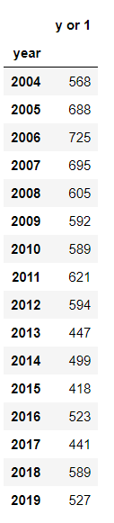
Results section where you discuss the results.
Test Case 2.1a: Data Analysis - UNDERINF vs year
Accident that the driver involved was under the influence of drugs or alcohol vs. Year
* 2020, no any record;
* y or 1, “drugs or alcohol”

Slide 21
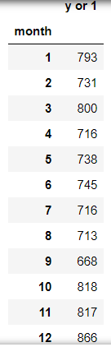
Results section where you discuss the results.
Test Case 2.1b UNDERINFL vs. month

Slide 22
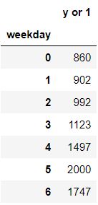
Results section where you discuss the results.
Test Case 2.1c UNDERINFL vs. weekday (# Monday = 0, Sunday = 6)

Slide 23
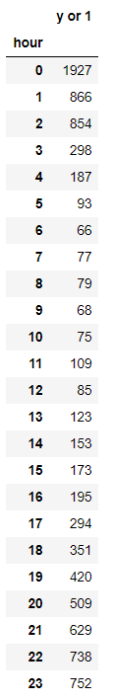
Results section where you discuss the results.
Test Case 2.1d UNDERINFL vs. hour

Slide 24
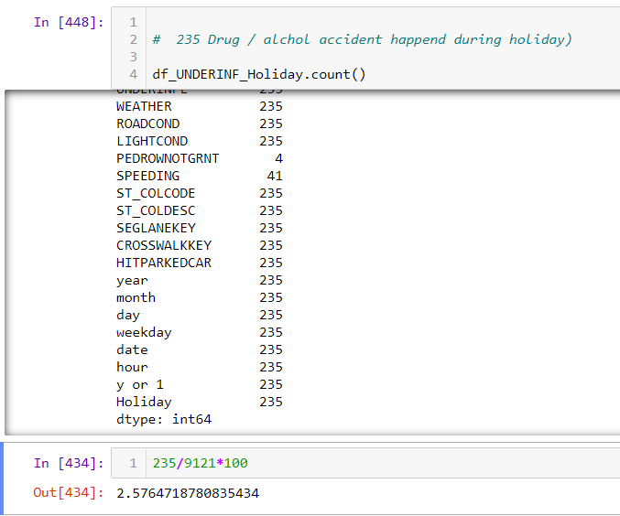
Results section where you discuss the results.
Test Case 2.1 e UNDERINFL vs. Holiday
Total - 235
Total incident caused by drug / alcohol = 9121, from 2004 to 2020.

Slide 25
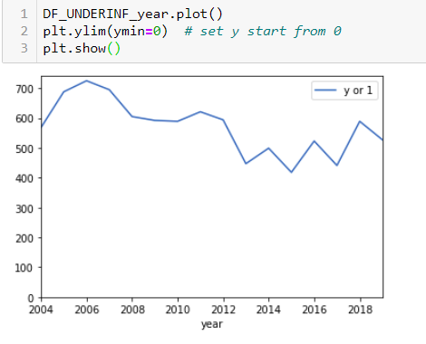
Results section where you discuss the results.
Test Case 3.1: UNDERINF (Graphic to Visualize the result)

Slide 26
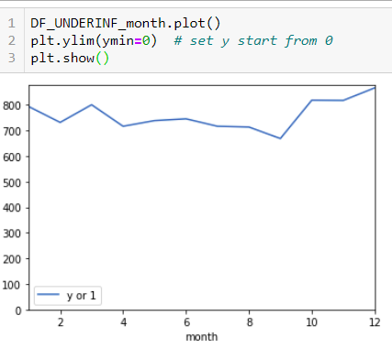
Results section where you discuss the results.
Test Case 3.1: UNDERINF (Graphic to Visualize the result)

Slide 27
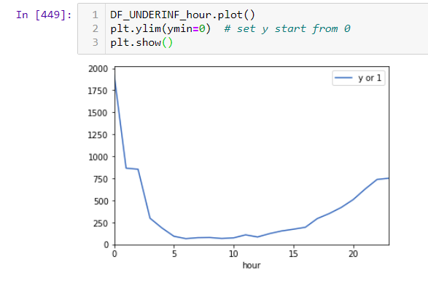
Results section where you discuss the results.
Test Case 3.1: UNDERINF (Graphic to Visualize the result)

Slide 28
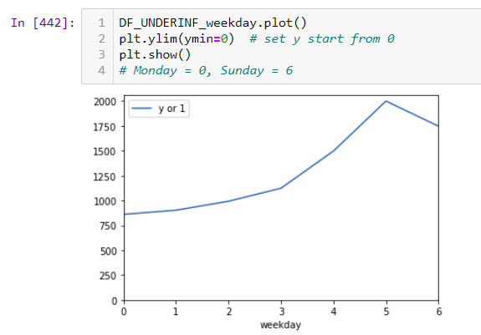
Results section where you discuss the results.
Test Case 3.1: UNDERINF (Graphic to Visualize the result)

Slide 29
Results section where you discuss the results.
Get insights by using correlation and Visualize the result
Using two potentially data to find the correlation

Slide 30
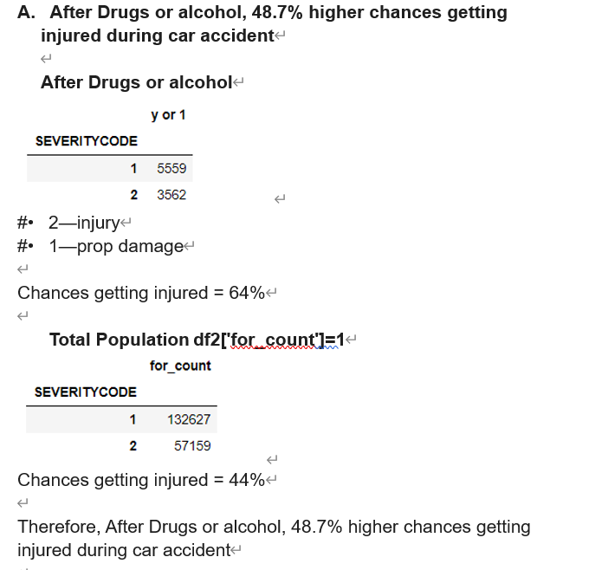
Results section where you discuss the results.
Test Case 4.1: Correlations of Drugs or alcohol vs other factors

Slide 31
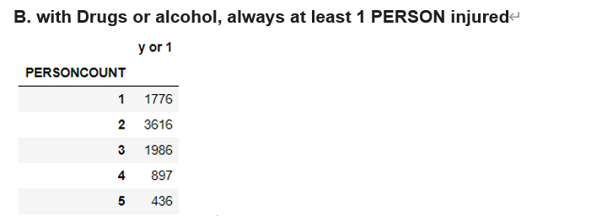
Results section where you discuss the results.
Test Case 4.1: Correlations of Drugs or alcohol vs other factors

Slide 32
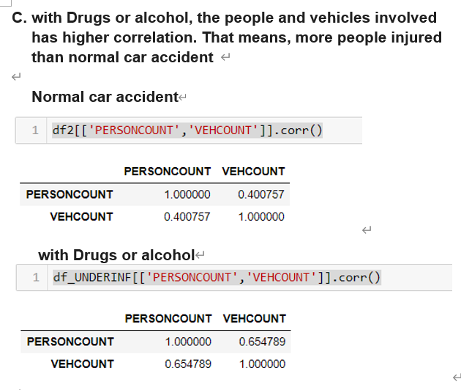
Results section where you discuss the results
Test Case 4.1: Correlations of Drugs or alcohol vs other factors

Slide 33
Discussion section where you discuss any observations you noted and any recommendations you can make based on the results.
For the Test Case 1: driver involved was under the influence of drugs or alcohol
We have the following result
1. Background data
2. driver involved was under the influence of drugs or alcohol ("drugs or alcohol") vs. Year
3. drugs or alcohol vs. Month
4. drugs or alcohol vs. hour
5. drugs or alcohol vs. weekday
6. drugs or alcohol vs. Holiday
Also, we have the graphic to show the Trend.

Slide 34
Discussion section where you discuss any observations you noted and any recommendations you can make based on the results.
Observations and Recommendations for test case 1:
1. Background data
Observations:
# Driver involved was under the influence of drugs or alcohol = 9121
# Total case = 189786
# Overall %9121/189786 = 4.81%
Around 5% of car accidents are caused by driver with drug & Alcohol, the percentage is High. This is a problem.
Premilitary recommendation
Education and controls are highly recommended and should be strength

Slide 35
Discussion section where you discuss any observations you noted and any recommendations you can make based on the results.
2. driver involved was under the influence of drugs or alcohol ("drugs or alcohol") vs. Year
Observations:
Based on the distribution of the result data, from 2004-2019 (2020 should be further investigate whether the data is missing or not entered), no significant down trend was observed. The trend is constantly high.
Premilitary recommendation:
Education and controls are highly recommended and should be strength

Slide 36
Discussion section where you discuss any observations you noted and any recommendations you can make based on the results.
3. drugs or alcohol vs. Month
Observations:
Based on the distribution of the result data, October – December have a slightly higher number of car accident caused by drugs or alcohol. However, the trend is constantly high.
The slightly higher number of car accident in Oct – Dec may due to holiday Season (Halloween and Christmas).
Premilitary recommendation:
More detective controls (e.g. increase number of patrolling police) and preventive controls (TV advertisement, News Paper advertisement, Radio broadcasting, etc.) should be implemented during the holiday season.
Warning should be in placed at the roads that have large traffic.

Slide 37
Discussion section where you discuss any observations you noted and any recommendations you can make based on the results.
4. drugs or alcohol vs. hour
Observations:
Based on the distribution of the result data, being from 21:00 until 0200, with the peak at 00:00, most car accident with alcohol and drug happened during this period of hours.
This may due to people gathering after the dinner time.
Premilitary recommendation:
More detective controls (e.g. increase number of patrolling police) and preventive controls (TV advertisement, News Paper advertisement, Radio broadcasting, etc.) should be implemented during these hours

Slide 38
Discussion section where you discuss any observations you noted and any recommendations you can make based on the results.
5. drugs or alcohol vs. weekday
Observations:
Based on the distribution of the result data, being from Friday to Sunday, with the peak on Saturday, most car accident with alcohol and drug happened during the weekend.
Premilitary recommendation:
More detective controls (e.g. increase number of patrolling police) and preventive controls (TV advertisement, News Paper advertisement, Radio broadcasting, etc.) should be implemented during these hours

Slide 39
Discussion section where you discuss any observations you noted and any recommendations you can make based on the results.
6. drugs or alcohol vs. Holiday
Observations:
# Driver involved was under the influence of drugs or alcohol = 9121
# happened on USA National Holiday = 235
# Overall =2.58%
It seems irrelevant.
Premilitary recommendation:
N/A

Slide 40
Conclusion section where you conclude the report.
Conclusion for test case 1:
Around 5% of car accidents are caused by driver with drug & Alcohol, the percentage is High. This is a problem.
The trend is constantly high and does not have any significant drop over the years. The following are key factors:
- October – December have a slightly higher number of car accident caused by drugs or alcohol.
- 21:00 until 0200, with the peak at 00:00, most car accident with alcohol and drug happened during this period of hours.
- being from Friday to Sunday, with the peak on Saturday, most car accident with alcohol and drug happened during the weekend
More detective controls (e.g. increase number of patrolling police) and preventive controls (TV advertisement, News Paper advertisement, Radio broadcasting, etc.) should be implemented during the date with above factor.
Warning Message (e.g. billboard) should be in placed at the roads that have high traffic.

Slide 41
Conclusion section where you conclude the report.
Lastly, the result of this report and the result data analysis may be preliminary, Further study of the results is required, e.g.
location black spot, vs weather
location black spot, vs 'PEDCOUNT,
in order to get more precise results and root cause.

